Slide 1
EATS for Middle and High School Nutrition Educator
Notes:
Pre/post student survey for grades 6+, administered online through Qualtrics public survey link
ADD Nutrition Educator’s name (red font)
Add pictures, graphics, animations that best fit your audience throughout the entire PPT.

Slide 2
Group Agreements
One mic
Make good choices
Take care
Be respectful
Have fun!
Notes:
OPTIONAL: Change agreements to fit age group/teaching environment

Slide 3
Survey Link
EATS Middle and High School
Notes:
Provide students with the Qualtrics survey link by copying and pasting it into the virtual platform available (Zoom Chat, Google Classroom, etc.).

Slide 4
Survey Introduction
Dear Student,
Hello! We are CalFresh Healthy Living, University of California (UC). Our program teaches young people about healthy eating and physical activity habits. Our goal is to help students stay healthy. Our program is funded by USDA. The program is free to your school or community.
To find out how well our lessons work, we ask that you complete this survey. However, completing the survey is totally voluntary. Voluntary means you can agree or not agree to complete it. It is up to you. You may also skip questions you do not want to answer. But, we hope that you will answer all of them. Any information about who you are will be kept secret. We will not share your name or id number.
If you have any questions about the survey, just ask us!
Notes:
Review consent page aloud with class – making sure to cover key points (in bold).
This is also the first page of the survey, so students will be able to read the consent as the first page of their survey.

Slide 5
Survey Contacts
Name of your local CalFresh Healthy Living, UC educator: ____________
Phone number: ____________
You may also contact our CalFresh Healthy Living, UC State Director: Kamaljeet Khaira, University of California at Davis, 1632 DaVinci Court, Room #31, Davis CA 95618 (530) 752-0555
If you have any concerns or complaints about our CalFresh Healthy Living, UC evaluation, you may also contact the Institutional Review Board, University of California at Davis at (916) 703-9151, from 8:00 a.m. to 5:00 p.m., Monday through Friday, or by writing to the Institutional Review Board, CTSC Bldg., Suite 1400, Rm. 1429, 2921 Stockton Blvd., Sacramento, California 95817.
Notes:
ADD local UCCE contact name and phone number (red line).
Share PDF file of student consent with the local UCCE contact details added (see administration protocol – VI. Student Consent).

Slide 6
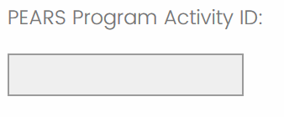
Survey: PEARS Program Activity ID
PEARS Program Activity ID: INSERT
Notes:
INSERT the PEARS Program Activity ID (6-digit numeric field) into PPT – for students to enter into their Qualtrics survey (see red font). Note: Create the direct education Program Activity in PEARS to generate the PEARS Program Activity ID (located just above Collaborators on the Program Activity summary page)
This is a required field, so student have to complete it in order to advance to the survey questions.
___________________
Say: For those who are willing, let’s complete the first page of the survey together. Let’s begin by filling in the PEARS Program Activity ID. I’ll put this number into the chat (it is also displayed in the PPT), so you can enter it.

Slide 7
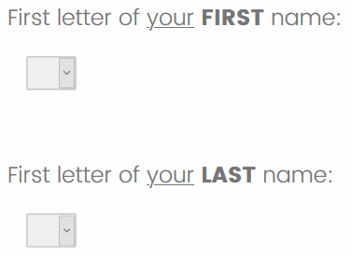
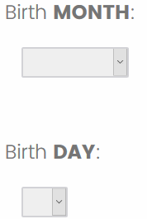
Survey: Unique ID
Notes:
Say: Now, let’s begin filling in your Unique ID. We use a code rather than your name to keep the information you share private. The next four questions create your Unique ID.
Select the FIRST letter of your FIRST name in the drop down. If your first name is Jose, you will enter ‘J’ for the first letter.
Next, select the FIRST letter of your LAST name in the drop down. If your last name is Ortega, you would enter ‘O’ for the first letter. Note: For students with multiple last names, ask them to use the first letter of their first last name.
Then, select your Birth MONTH.
And, select your Birth DAY.
Do: Take time to answer any questions. These are required fields, so student have to complete them in order to advance to the survey questions.

Slide 8
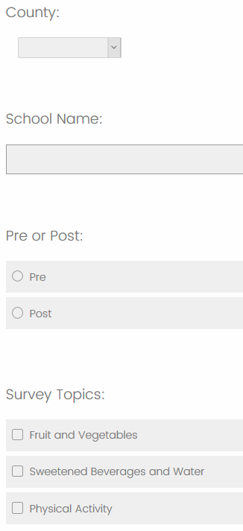
Survey: Program Evaluation
County: INSERT
School Name: INSERT
Pre or Post: INSERT
Survey Topics: INSERT
Notes:
INSERT the following information into PPT (see red font) – for students to enter into their Qualtrics survey: County, School Name, Pre or Post, and Survey Topics (list the modules you want students to complete – Fruit and Vegetables, Sweetened Beverages and Water, and/or Physical Activity)
These are required fields, so student have to complete them in order to advance to the survey questions.
_________________________
Say: Next, let’s fill in the County, School Name, Pre or Post, and Survey Topics questions. I’ll put this information into the chat (or display it in PPT), so you can enter them. Please verify that you selected the correct Survey Topics. If not, you can use the back arrow to correct your selections.
Note: The online EATS survey will only display the Survey Topics selected, so please work with students to select the correct modules.
When you see the correct Survey Topics, click the forward arrow to continue the survey.

Slide 9
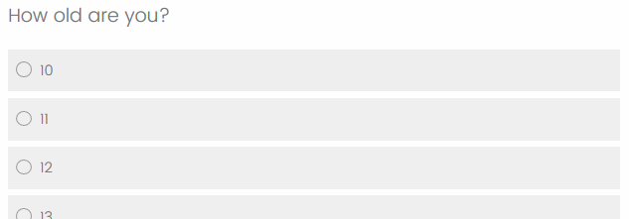
Survey: Student Information
Notes:
Say: For the rest of the survey, wherever you see a bubble (or circle), choose the ONE best answer for the question. Wherever you see a box (or square), choose each answer that is true for you. This is not a test, and there are no right or wrong answers. Please just respond to the questions as honestly and accurately as you can.
Now, let’s read through the first part of the survey together.
Do: Wait for students to finish each question before moving on.
Say: The next section, Student Information, is about you.
For the Pre-Survey, continue below.
For the Post-Survey, SKIP to the next slide
_________________________
For the Pre-Survey only:
Bubble in your age.
Bubble in your grade. (Do: if class is a single grade, provide the answer) For this class, you would bubble in ­­­___ grade.
Bubble in the gender option that best describes you. It’s ok if you don’t want to answer this question. In that case, bubble in “Prefer not to answer”.
Next - How do you describe yourself? Choose all the boxes that best describe you. It’s ok if you don’t want to answer this question. In that case, please leave it blank.

Slide 10
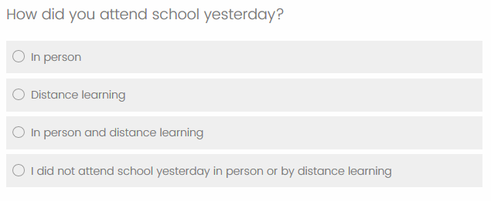
Survey: Student Information
Notes:
_______________________________
For the Pre- and Post-Surveys:
Bubble in how you attended school yesterday.
The next questions are about what you ate or drank yesterday.
Bubble in whether you ate the school lunch at school, at home, or did not eat school lunch for lunch yesterday.
Bubble in whether you ate the school breakfast at school, at home, or did not eat school breakfast for breakfast yesterday.

Slide 11
What Did You Eat/Drink Yesterday?
Yesterday: INSERT day of the week / date
School?
Home?
At a friend’s or relative’s house?
A fast food restaurant?
Another restaurant?
Somewhere else?
Breakfast?
Morning snack?
Lunch?
Afternoon snack?
Dinner?
School Breakfast: ADD relevant menu items
School Lunch: ADD relevant menu items
Notes:
If administering the Fruit and Vegetables or Sweetened Beverages/Water Module, include these prompts to help youth recall yesterday’s intake. Otherwise SKIP to slide 14 for Physical Activity.
INSERT yesterday’s DAY of the week and DATE into PPT (see red font).
For students participating in school meals, ADD the school breakfast and lunch menu items provided for yesterday or the week – as relevant (see red font).
____________________________
Say: Now there are questions about foods and beverages that you ate or drank yesterday. Yesterday was (name of day). Think about what you ate and what you drank yesterday. Please count only what you ate or drank yesterday, even if it was not a normal day for you. On the PPT, I’ve written some places to help you remember where you were yesterday, the names of different meals, and what was provided for school breakfast and lunch. Let’s do an example to see how to answer this type of question. Take a minute to reflect on what you ate (name of day). Feel free to write your responses down to help you answer the next few questions.

Slide 12
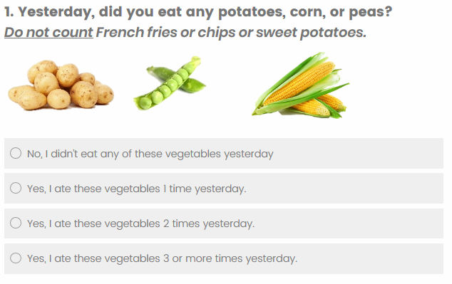
Survey: Fruit and Vegetables Module
Notes:
If administering the Fruit and Vegetables Module, continue below. Otherwise, SKIP to the next slide for Sweetened Beverages and Water.
_______________________________
We’re going to look at question #1. Yesterday, did you eat any potatoes, corn, or peas? Suppose you had a scoop of corn as part of school lunch and roasted potatoes as a side dish with dinner. Which circle would you bubble in?
Do: Wait for responses.
Say: You ate corn 1 time at lunch, and potatoes 1 time at dinner, so you ate potatoes, corn, or peas a total of 2 times yesterday. You would bubble in the circle for “Yes, I ate these vegetables 2 times yesterday”. Remember, when you answer this question on your survey, think about only the vegetables you ate yesterday.
Are there any questions about the instructions I’ve just explained?
Do: Answer any questions about the survey. If students ask questions about specific survey questions, help clarify the questions for the students, but do not provide answers.
Say: If you have a question while you are taking the survey, please raise your hand (or send me a private chat message) and I will help you. Remember, the pictures are examples only and do not necessarily include all the possible foods or beverages covered by the question. What you ate or drank may have looked different.
Do: For online survey administration, read the questionnaire aloud to minimize chatter and keep students on task – if appropriate for the age-group.
Say: After you complete the module, click the forward arrow.

Slide 13
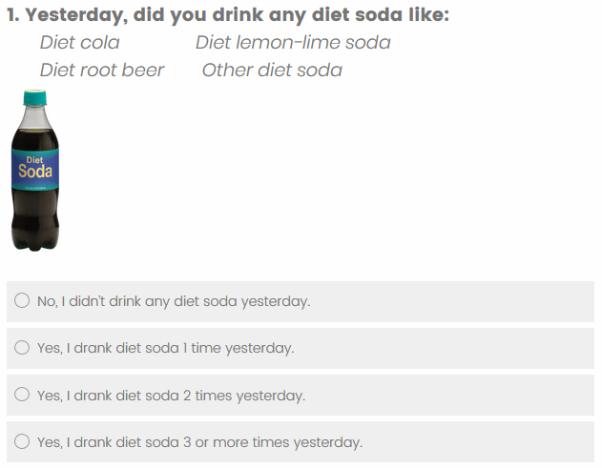
Survey: Sweetened Beverages and Water Module
Notes:
If administering the Sweetened Beverages and Water Module, continue below. Otherwise, SKIP to the next slide for Physical Activity.
_______________________________
We’re going to look at question #1. Yesterday, did you drink any diet soda like: diet cola, diet root beer, diet lemon-lime soda, or other diet soda? Suppose you had a diet cola with lunch and a diet root beer float for dessert after dinner. Which circle would you bubble in?
Do: Wait for responses.
Say: You drank diet cola 1 time at lunch, and diet root beer 1 time after dinner, so you drank diet soda a total of 2 times yesterday. You would bubble in the circle for “Yes, I drank diet soda 2 times yesterday”. Remember, when you answer this question on your survey, think about only the diet soda you drank yesterday.
Are there any questions about the instructions I’ve just explained?
Do: Answer any questions about the survey. If students ask questions about specific survey questions, help clarify the questions for the students, but do not provide answers.
Say: If you have a question while you are taking the survey, please raise your hand (or send me a private chat message) and I will help you. Remember, the pictures are examples only and do not necessarily include all the possible beverages covered by the question. What you ate or drank may have looked different.
Do: For online survey administration, read the questionnaire aloud to minimize chatter and keep students on task – if appropriate for age-group.
Say: After you complete the module, click the forward arrow.

Slide 14
When Were You Physical Activity Last Week?
Last Week: INSERT last 7 days / date range
Days active for 60+ mins? (e.g. heart beating fast and breathing hard) Home? School? Park? Sports practice/activity classes?
Days with PE or school team sports?
PE or school team sport activities?
Notes:
If administering the Physical Activity Module, include these prompts to help youth recall last week’s physical activity.
INSERT last seven DAYS and DATE RANGE into PPT (see red font).
_________________________
Say: Please stop when you get to Physical Activity so the group can catch up.
Do: Allow time for the class to catch up.
Say: The next questions are about your physical activity. For these questions, we want you to think about last week rather than yesterday. Remember, for the questions with boxes (squares), you should select all answers that are true for you. When we ask about physical activity, this includes sports or dance that make you sweat or make your legs feel tired, or games that make you breathe hard, like tag, skipping, running, climbing, and others. When recalling your time at school (include both in-person and distance learning) and think about the time you spent playing sports, physically active games, playing actively with friends, or other activities that got your body moving. Also, walking counts as physical activity, but only if you did it for more than 10 minutes at a time.
Please take a minute to reflect over the past week (name day through day):
On which days were you active for 60 minutes or more?
When did you have PE or school team sports?
What activities did you do in PE or school team sports?
Feel free to write your responses down to help you answer the next set of questions.

Slide 15
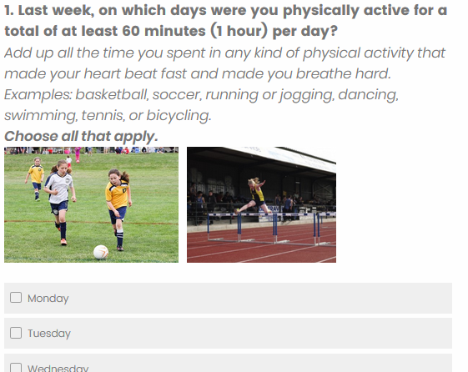
Survey: Physical Activity Module
Notes:
If administering the Physical Activity Module, continue below. Otherwise, SKIP to the next slide.
_______________________________
Say: Let’s look at question 1 together. Last week, on which days were you physically active for a total of at least 60 minutes (1 hour) per day? Add up all the time you spent in any kind of physical activity that made your heart beat fast and made you breathe hard. Some examples include: basketball, soccer, running or jogging, dancing, swimming, tennis, or bicycling.
Select the box next to each of the days that apply. If you were not physically active for at least 60 minutes on any of these days last week, check the last box.
Are there any questions about the instructions I’ve just explained?
Do: Answer any questions about the survey. If students ask questions about specific survey questions, help clarify the questions for the students, but do not provide answers.
Say: If you have a question while you are taking the survey, please raise your hand (or send me a private chat message) and I will help you. Remember, the pictures are examples only and do not necessarily include all the possible types of physical activities covered by the question. The physical activities that you did may have looked different.
For online survey administration, continue by reading the questionnaire aloud to minimize chatter and keep students on task – if appropriate for the age-group.
Say: After you complete the survey, make sure you click the forward arrow to submit your survey.

Slide 16
This is the end of the survey.
Please click the forward arrow to submit your survey.
Thank you for participating!

