Slide 1
Virtual Physical Activity Breaks CalFresh Healthy Living, UC Cooperative Extension Riverside County
Notes:
Claudia, SCRIPT: Thank you Michele! Good afternoon everyone, I’m Claudia Carlos, Program Supervisor in Riverside County. The request to provide a professional development on Virtual Physical Activity Breaks for the Alvord Unified School District staff came from the Wellness lead at Loma Vista Middle School after sustaining a strong partnership with Loma Vista and providing comprehensive programing for 10+ years. We are grateful for the opportunity to have reached 670 staff members with our presentation. With short notice, we really had to work together as a team on this project.

Slide 2
Meet CFHL, UCCE Riverside County's Nutrition Educators
Claudia Carlos
Daisy Valdez
Itzel Palacios
Nicole Ogosi
Jackie Barahona
Esmeralda Nunez
Inrom F
Notes:
Claudia,
SCRIPT: Let’s meet the terrific team. Presenting with me today is Jackie Barahona, Itzel Palacios-Sanchez, Nicole Ogosi, Daisy Valdez,and Esmeralda Nunez. To get started, I’ll pass it to Itzel.

Slide 3
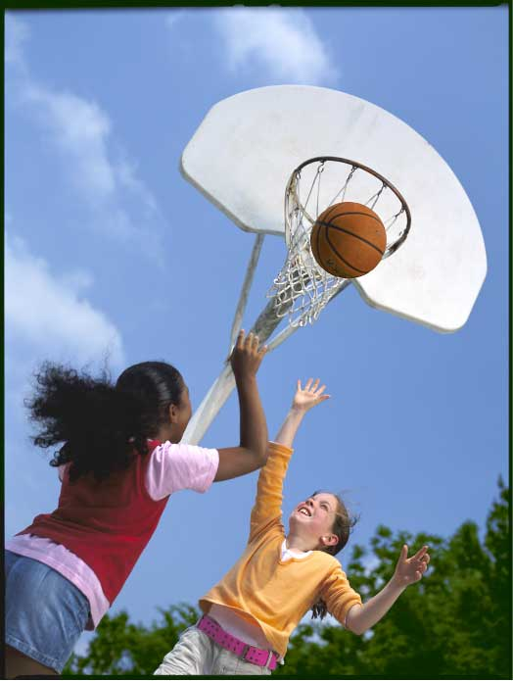
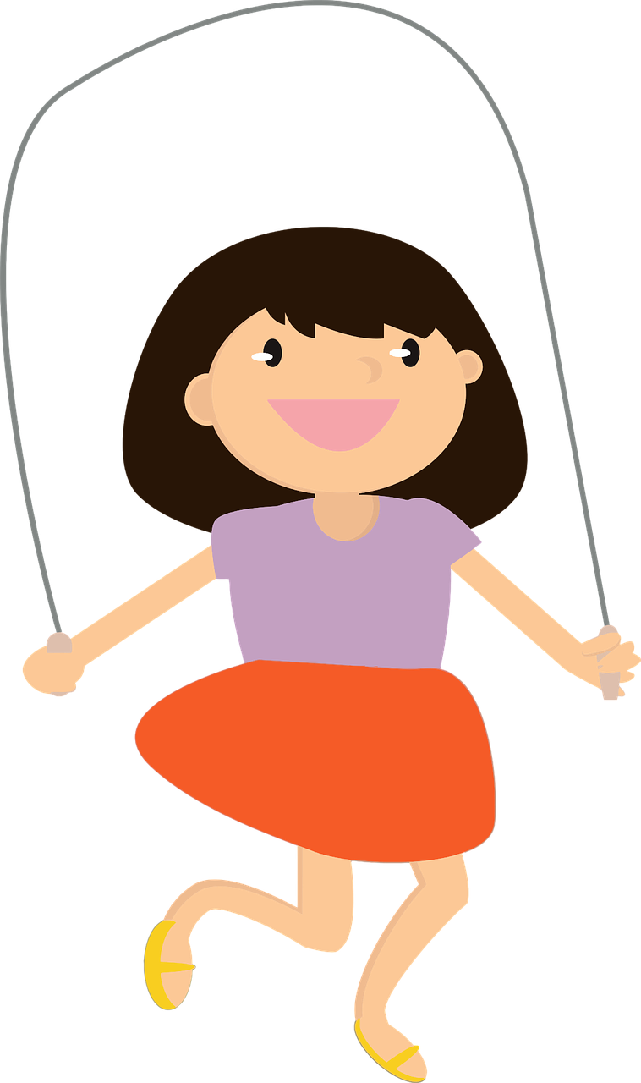
Objectives
Explore the benefits of virtual PA Breaks
Share resources & websites
Recommend 4 virtual PA activities for the following grade levels:
-Lower Elementary -Middle School
-Upper Elementary -High School
Photo by Pixabay
Notes:
Itzel, SCRIPT: Thank you Claudia!
For this presentation we will explore the benefits of PA Breaks for different grade levels.
We will share multiple PA resources with you. These resources have been selected for teachers in mind.

Slide 4
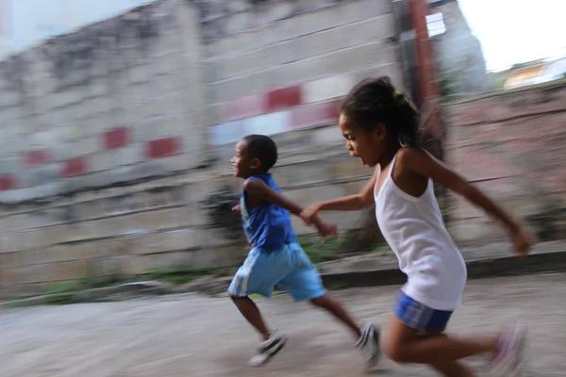
Why is Physical Activity Important?
Menti.com Code:
Please log onto Menti.com and enter the code
to answer. You can enter up to 3 responses.
Notes:
Jackie- SCRIPT: Thank you Itzel! We started off with an icebreaker, that we’ll be using today. For today’s question, we will be using Menti.com. “Why is physical activity important?” Please go to menti.com and enter the code: 25 57 86 9. You can also find this information at the top left portion of this slide and in the chat. You will be allowed to enter up to 3 responses. Another option is that you can open your camera to scan the QR code on the slide. If you can’t access Menti.com please respond in the Chat. Thank you for participating in today’s icebreaker, now back to Itzel.

Slide 5
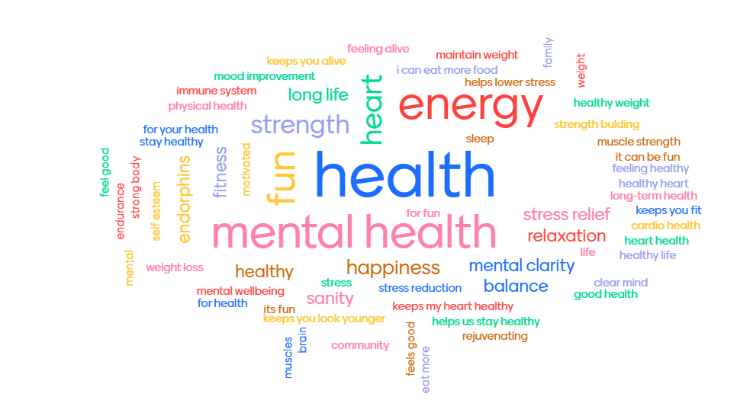
Why is Physical Activity Important?
Notes:
Itzel
SCRIPT: Thank you for that great ice breaker Jackie! Those were some great responses.

Slide 6
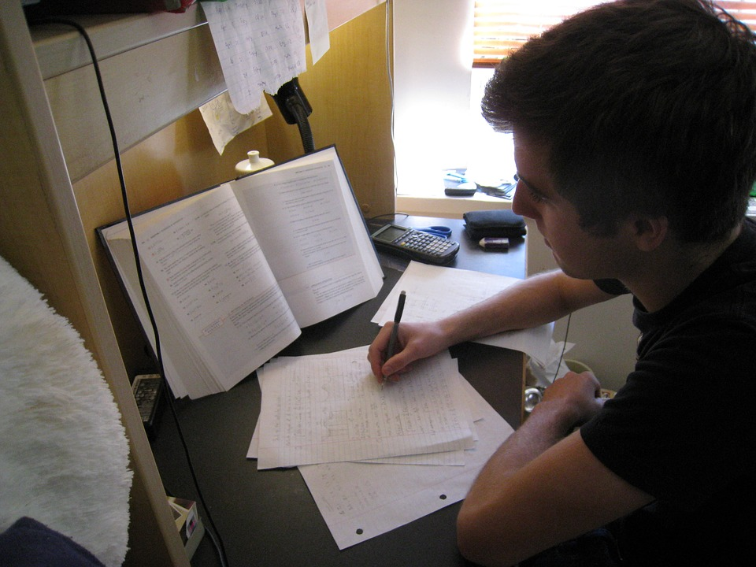
PA Breaks Benefit Students
Improving concentration
Reducing disruptive behavior
Improving motivation and engagement
Increasing amount of daily physical activity
Improving academic performance
Notes:
Itzel SCRIPT :We will start off with some general student benefits. According to the CDC student concentration will be improved along with their ability to stay on-task. PA breaks can help reduce disruptive behavior like fidgeting. They can also help improve motivation and engagement in learning as well as improving academic performance (grades) and finally PA breaks can help increase the amount of PA students perform helping them meet the recommended daily 60 minutes of physical activity.

Slide 7
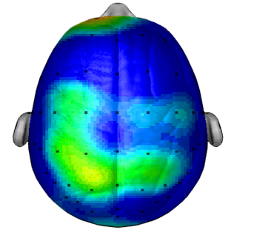
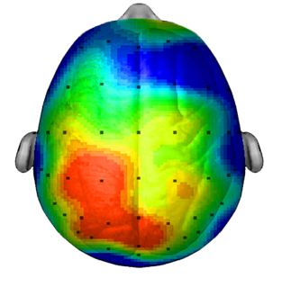
PA and the Brain
AFTER SITTING QUIETLY
AFTER 20 MINUTE WALK
Hillman, C.H. The Effect of Acute Treadmill Walking on Cognitive Control & Academic Achievement in Preadolescent Children. 2009. 9
Notes:
Daisy Script: Thank you Itzel What we talked about here - In this section we highlighted the physicochemical connection and benefits that result from the Physical activity breaks. We showed these two slides that demonstrate how brain activity increases and helps students perform better on tests.

Slide 8
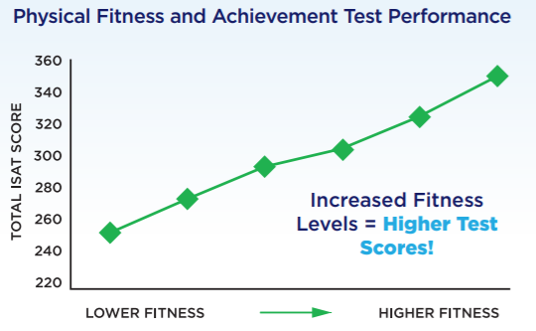
Active Students are Better Learners
shapeamerica.org/advocacy
Notes:
Daisy Script: By referencing scientific research and experts in this field we attempted to persuade and educate our audience about the benefits of PA, through logos. in other sections we highlighted more of the emotional and ethical benefits.

Slide 9
PA Break for TK-2nd Grade
Please join Daisy Valdez as she leads us on a PA break found on the GoNoodle website. ​
Note: GoNoodle is a collection of videos designed to get students of all ages moving. It is free for educators and families.
Notes:
Daisy: Script: At this moment I lead a movement break that is suitable for lower elementary students pre-K through 2nd grade students. The resource we highlighted here was a GoNoodle dance video. Everyone on the call was excited to try it out.
So let’s give it a quick try ourselves! If you are able to, please stand and follow along with the dance video and have fun.
Play first 30 second of “I Go a Feeling”GoNoodle dance video.
Great thank you for participating!

Slide 10
GoNoodle Website
Notes:
Daisy Script: Many of us are already familiar with GoNoodle as a great collection of of PA videos for students k-12.

Slide 11
GoNoodle Channels
Notes:
Daisy script: After each brain break we checked in with the teachers, asking them how the activity made them feel.

Slide 12
The Science
Oxygen and glucose
Neurogenesis (growth of brain cells)
Neurotransmitters (ie. Serotonin, Dopamine, and Histamine)
Notes:
Daisy Script: After the PA, I asked them if they felt more energized? - How did you all feel right now? Did you smile and laugh at any point in the activity? Let us know in the chat.
I explained that the positive reactions they were having maybe a result
of what happens on the molecular level in the brain.
I listed the neurological reactions that occur in the brain as a result of PA.
This helped us build up to the emotional, behavioral, and physical benefits that can be observed when we are physically active.
Jackie will now share another virtual PA Break resource.

Slide 13
PA Break 3-5 Grade
Please join Jackie Barahona as she leads us on a PA Break found on the Sanford Fit website.​
Note: Sanford Fit is free for educators and families. This video includes equipment, but the workouts can be done without equipment.
Notes:
Jackie-
SCRIPT: Thank you Daisy. This is where I lead the teachers in a movement break that is suitable for 3rd -5th grade students from Sanford Fit. For those of you who are not familiar with Sanford Fit, this is a great PA resource that is free for teachers and educators.

Slide 14
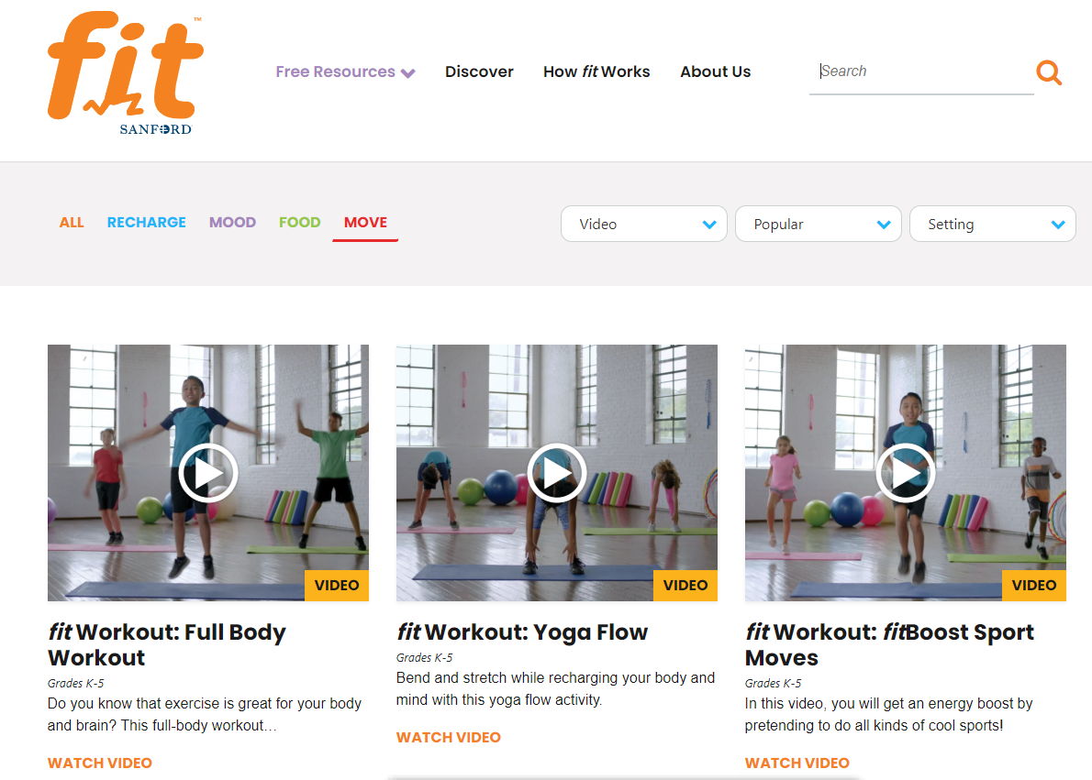
Sanford Fit Website
Notes:
Jackie-SCRIPT: T here I showcased the Sanford Fit website and discussed how they provide short, fun PA videos. Now back to Daisy.

Slide 15
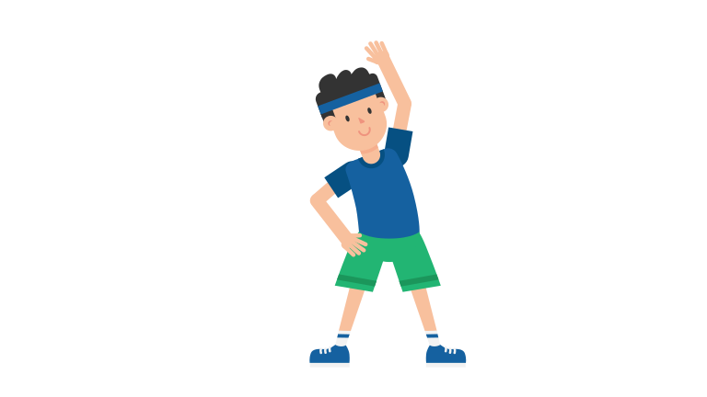
Lasting Benefits
Benefits of Physical Activity will last 20 minutes to be in a better state of learning.​
Benefits of Exercise will last 60-90 minutes- this is how long the brain will be primed for learning. ​
Notes:
Daisy Script:
To close off this section we highlighted the lasting benefits of PA breaks. I spoke about how the time and intensity of PA breaks is correlated to the length of time the students are focused.
Next Nicole will demonstafe another PA break that we created for Middle school age students. Take it away Nicole!

Slide 16
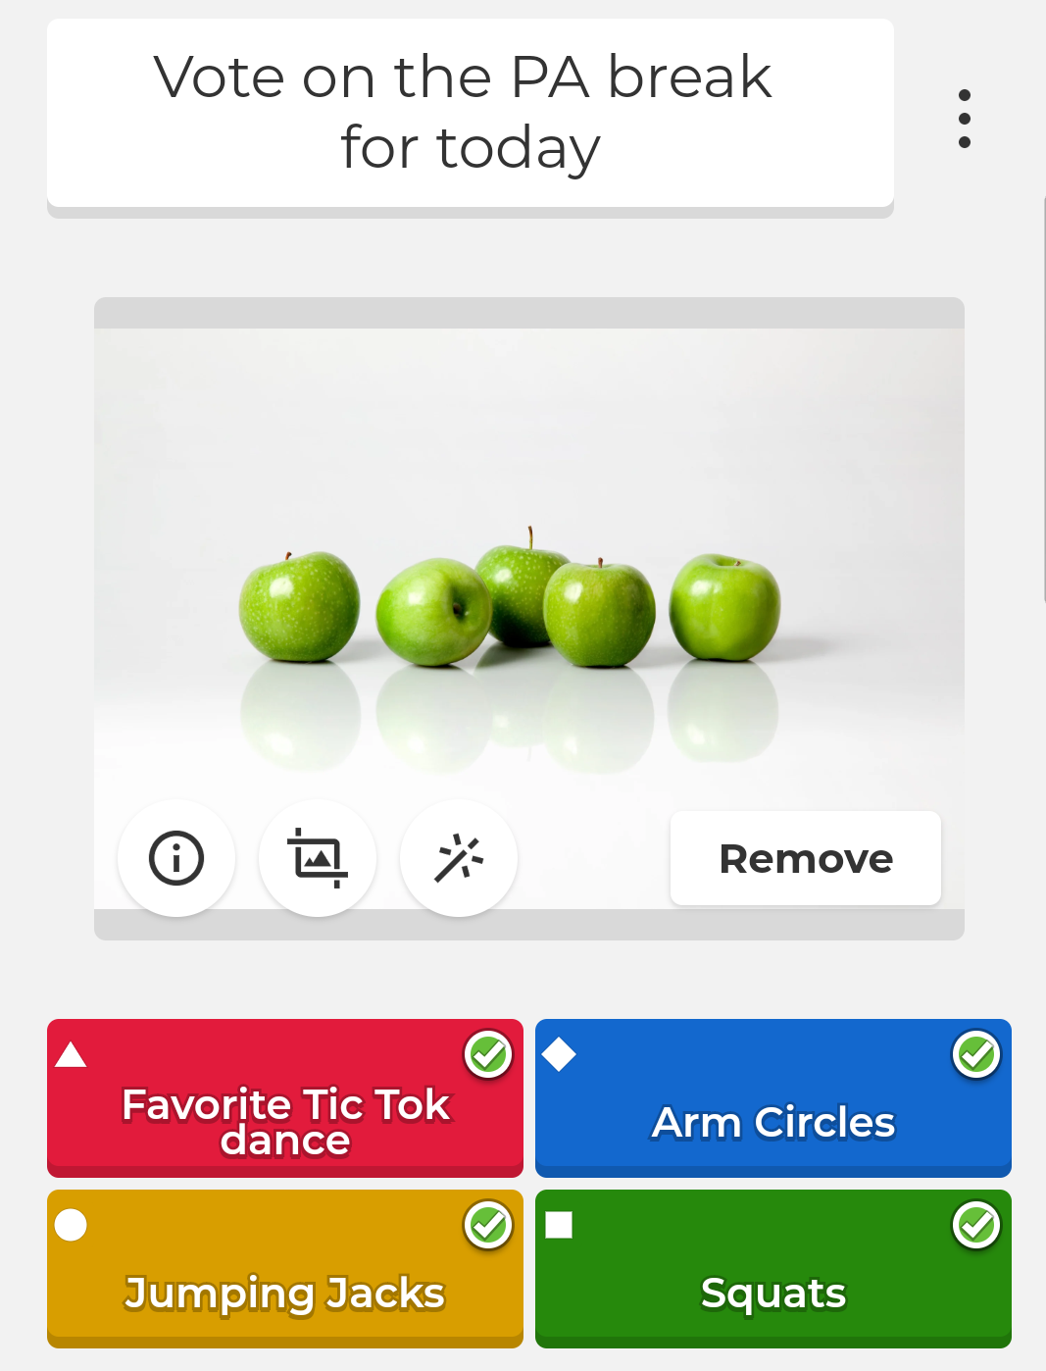
PA Break Middle School
Please join Nicole Ogosi as she leads us using a PA Break.​
Class challenge
Popcorn (with exercises)
Kahoot game
Dice Roller on Google- roll once for the activity (from premade list) and roll second time for amount
Notes:
Nicole-In this slide I highlighted all the different possible PA breaks middle school teachers can do with their classes.
During the call today I want to demonstrate the last one. For the Dice roller game: Google dice roller. First roll chooses the activity and the second is how many times that activity is performed. So Claudia, If you could roll the dice twice.

Slide 17
Premade Exercise List
1 Jumping Jacks | 2 Squats
3 Arm Circles | 4 Calf raises
5 Jog in place | 6 Lunges
Notes:
Nicole-Nicole, How do you feel after those _________? please feel free to share in the chat

Slide 18
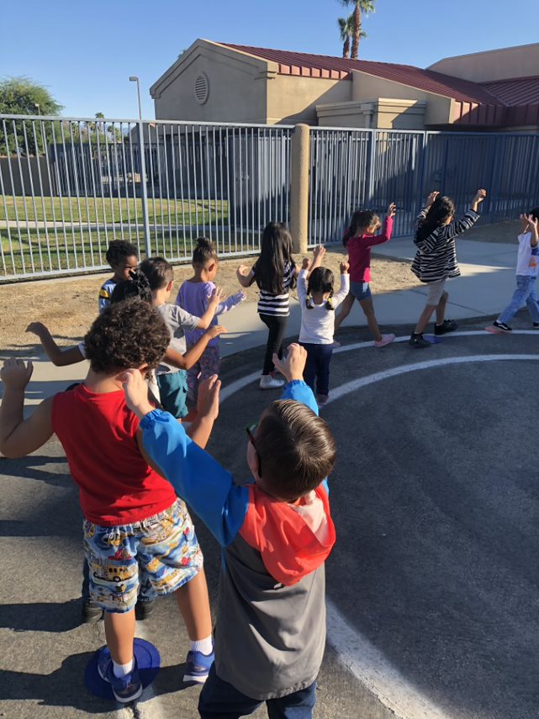
Increases strength and endurance
Strengthens bones and muscles
Helps control weight
Improved health
PA and the Body
Physical Activity Guidelines for Americans: 2nd Edition
Notes:
Nicole:We talked about how having consistent PA can affect the body

Slide 19
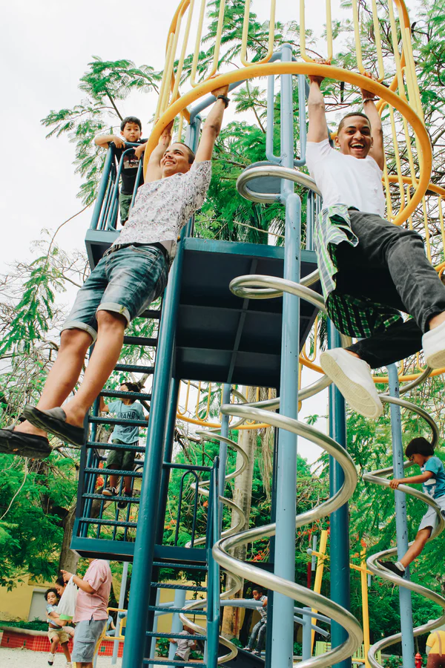
Increases self-esteem
Regulates sleep and appetite
Provides sense of accomplishment
Helps reduce anxiety, stress, and depression
Socioemotional Benefits
Notes:
On the next slide we touched upon not only the physical benefits of PA, but social/emotional benefits. pa, and pa breaks in the classroom can boost confidence, improve sleep and most importantly can reduce stress anxiety and depression that may be at all-time high during this uncertain time.
Frazer A, Hensler JG. Serotonin Involvement in Physiological Function and Behavior. In: Siegel GJ, Agranoff BW, Albers RW, et al., editors. Basic Neurochemistry: Molecular, Cellular and Medical Aspects. 6th edition. Philadelphia: Lippincott-Raven; 1999. Available from: https://www.ncbi.nlm.nih.gov/books/NBK27940/

Slide 20
Become your students’ favorite teacher!
Build trust and a sense of belonging
Builds classroom community
Bonding between classmates
Creates memories
World’s Best
Teacher
👩‍🏫
Notes:
Nicole
Here we talked about how having fun and introducing PA breaks in the classroom can lead students to remember them the teacher as well as material for a long time
Now Itzel will explore PA breaks for HS students

Slide 21
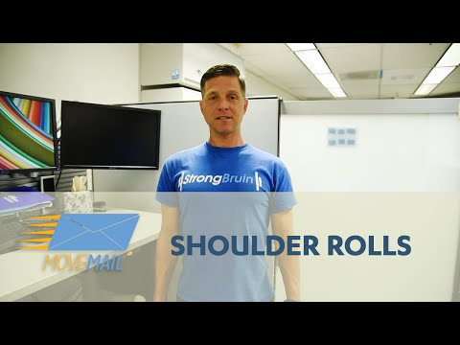
PA Break High School
Please join Itzel Palacios-Sanchez as she leads us using a PA Activity Breaks found on the UCLA Recreation Move Mail website:
American Heart Association
In-school activity breaks
UCLA Recreation Move Mail
Notes:
Itzel SCRIPT: Thank you Nicole! For our last grade group, which is our high school students, we included the following PA resources. It was important to mention that older youth like to be treated as adults, and that giving youth the option of choosing the PA activity they want to to can make it more engaging for them and their peers. Luckily many organizations like the AHA have resources as well. “In-class activity breaks” provides many activities that are meant to be in group settings but we mentioned that they can be easily adapted to distance learning. The second resource we shared was a video from UCLA Recreation Move Mail which we will also try with you today!

Slide 22
Priming the Brain for Learning
​ “Exercise is the single most​
powerful tool you have to​
optimize your brain​
Function.”​
“activity and learning are inextricably woven.”​
​
John J. Ratey, MD​
Notes:
Itzel- SCRIPT: How do you all feel now after the activity? Do you feel less tense, more relaxed? Share with us how you are feeling in the chat! According to Dr. Ratey, by including PA breaks in the school day, we are priming the brain for learning.

Slide 23
As Easy as 1, 2, 3
Step 1 | STEP 2: | STEP 3:
Set Clear Expectations Describe appropriate behavior Establish a class/group agreement Planning Make it intentional Make it routine | Establish Start & Stop Signals Volume Have a back up Space & Boundaries | Make it FUN! Include student choice Track progress & create an incentive Stay focused with calm movement (Examples: breathing, balance, stretches)
Catchglobal. “Coordinated School Health - Health Education Programs.” CATCH, catchinfo.org/.
Notes:
Itzel SCRIPT: Adding breaks to your class can be as easy as 1,2,3! These are some strategies to keep in mind when planning to include PA breaks. Making PA breaks a routine can render better results for students. There is a chance that one may run into problems when showing videos or sharing links, so have a back up plan. And last but definitely not least Make it fun! You’d be surprised how much some of these PA activities can influence your students. Jackie will talk about an example of how planned PA breaks could look on a schedule on the next slide

Slide 24
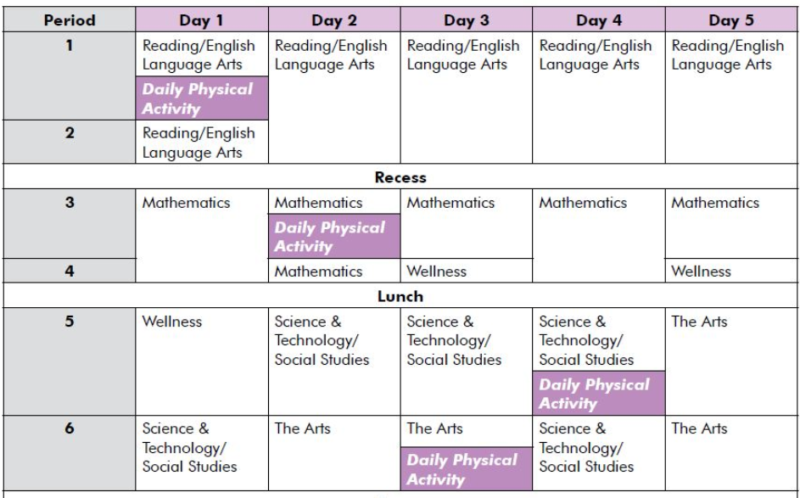
Schedule PA Breaks
Notes:
Jackie SCRIPT: Here’s an example of how to schedule PA breaks in your school day. We wanted to emphasize that it does not matter when you move, just make sure to move throughout the day!

Slide 25
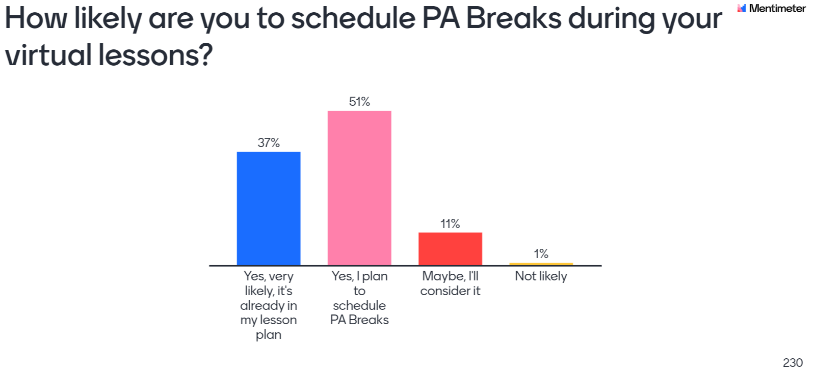
Poll
Notes:
Jackie- SCRIPT: As we wrapped up our presentation, we had a final poll question. Out of the 230 teachers who responded to the Mentimeter poll, 88% said they were very likely or planning to schedule PA breaks during their virtual lessons. Now I will pass it to Esmeralda to talk about teacher feedback and how we distributed PA Break resources.

Slide 26
Feedback
“You were amazing! Teachers in the stands loved it and they loved the opportunities to stand up. One teacher said it was the best session of the day.”
- Mr. Tan
AUSD Teacher
Notes:
Esmeralda-SCRIPT: Thank you Jackie. The feedback from our presentation was very positive. “You were amazing! Teachers in the stands loved it and they loved the opportunities to stand up. One teacher said it was the best session of the day.” As a result of this presentation we were also invited to present to California Association for Health, Physical Education, Recreation & Dance, otherwise known as CAHPERD.

Slide 27
PA Break Resources
Please see the spreadsheet of PA Break links in the Chat
American Heart Association In-School Activity Breaks
Fuel Up to Play 60 Physical Activity Good-for-Mind-and-Body
CDC Strategies for Classroom Physical Activity in Schools
Action for Healthy Kids PA Classroom Tracker
The Colorado Education Initiative Take a PA Break! Teacher Toolkit for Secondary Classrooms
Online Physical Education Network Active Classrooms
Shape America PE + Health = Student Success
Hip Hop Public Health Physical Activity Videos
Notes:
Esmeralda-SCRIPT: We are hopeful that Alvord students will greatly benefit from the resources shared at this session. We provided a list of resources to the teachers.

Slide 28
Works Cited
Advanced Solutions International, Inc. “SHAPE America.” Physical Education and Health Education-Shape America, www.shapeamerica.org/.
Catchglobal. “Coordinated School Health - Health Education Programs.” CATCH, catchinfo.org/.
Classroom Physical Activity.” Centers for Disease Control and Prevention, Centers for Disease Control and Prevention, 29 May 2019, www.cdc.gov/healthyschools/physicalactivity/classroom-pa.htm.
Frazer A, Hensler JG. Serotonin Involvement in Physiological Function and Behavior. In: Siegel GJ, Agranoff BW, Albers RW, et al., editors. Basic Neurochemistry: Molecular, Cellular and Medical Aspects. 6th edition. Philadelphia: Lippincott-Raven; 1999. Available from: https://www.ncbi.nlm.nih.gov/books/NBK27940/
Learning, Action Based. Action Based Learning, www.youthfit.com/.
Ratey, John J., and Eric Hagerman. Spark the Revolutionary New Science of Exercise and the Brain. Little Brown & Company, 2008.
“Supporting Neuroscience & Brain Research.” Dana Foundation, dana.org/.
Tarr, B., Launay, J., Benson, C. et al. ‘Naltrexone Blocks Endorphins Released when Dancing in Synchrony’. Adaptive Human Behavior and Physiology 3, 241–254 (2017). https://doi.org/10.1007/s40750-017-0067-y
U.S. Department of Health and Human Services. Physical Activity Guidelines for Americans, 2nd edition. Washington, DC: U.S. Department of Health and Human Services; 2018.

Slide 29
Thank you!
Claudia Carlos
Program Supervisor
CFHL, UCCE - Riverside County
cfcarlos@ucanr.edu http://ceriverside.ucanr.edu/NFCS/FSNEP/
Follow us and stay connected!
@CFHL_UCCE_RiversideCo
@CFHL.UCCE.RiversideCo
Notes:
Esmeralda SCRIPT: -We shared our social media accounts with them and encouraged them to follow us on Instagram and Facebook to stay connected. Thank you on behalf of the CFHL, UCCE Riverside Team! For any questions or comments please contact our Program Supervisor Claudia Carlos. The Riverside team would like to express gratitude to Michele Tabor for her time and support on this project.

Slide 30
California's CalFresh Healthy Living, with funding from the United States Department of Agriculture’s Supplemental Nutrition Assistance Program – USDA SNAP, produced this material. These institutions are equal opportunity providers and employers. For important nutrition information, visit the CalFresh Healthy Living website.
It is the policy of the University of California (UC) and the UC Division of Agriculture & Natural Resources not to engage in discrimination against or harassment of any person in any of its programs or activities (Complete nondiscrimination policy statement can be found at http://ucanr.edu/sites/anrstaff/files/215244.pdf)
Inquiries regarding ANR’s nondiscrimination policies may be directed to UCANR, Affirmative Action Compliance & Title IX Officer, University of California, Agriculture and Natural Resources, 2801 Second Street, Davis, CA 95618, (530) 750-1343.

Slide 31
In accordance with Federal law and U.S. Department of Agriculture (USDA) civil rights regulations and policies, this institution is prohibited from discriminating on the basis of race, color, national origin, sex, religious creed, disability, age, political beliefs, or reprisal or retaliation for prior civil rights activity.
To file a program discrimination complaint, a complainant should complete a Form AD-3027, USDA Program Discrimination Complaint Form, which can be obtained online at https://www.ascr.usda.gov/sites/default/files/ USDA-OASCR%20P-Complaint-Form-0508-0002-508-11-28- 17Fax2Mail.pdf, from any USDA office, by calling (866) 632-9992, or by writing a letter addressed to USDA. The letter must contain the complainant’s name, address, telephone number and a written description of the alleged discriminatory action in sufficient detail to inform the Assistant Secretary for Civil Rights (ASCR) about the nature and date of an alleged civil rights violation. The completed AD-3027 form or letter must be submitted to USDA by:
mail:
U.S. Department of Agriculture
Office of the Assistant Secretary for Civil Rights
1400 Independence Avenue, SW Washington, D.C. 20250-9410; or
fax: (833) 256-1665 or (202) 690-7442;
email: program.intake@usda.gov.
This institution is an equal opportunity provider.
https://www.ascr.usda.gov/sites/default/files/JFAblue508.pdf

